Slide 1
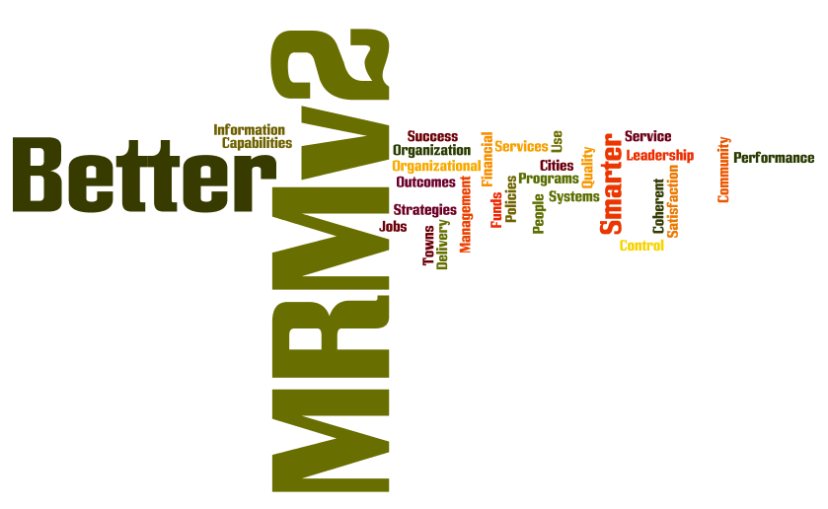
Some Context
MRMv2 Vision Session
Skip Lumley December 2011

Slide 2
Some Context
Subscriber’s Line of Sight
MRMv2 Value Equation
An Abridged History
What Does the MRMv2 Want to Be?
Supplementary Information

Slide 3
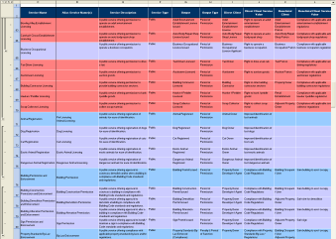
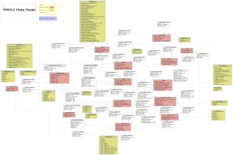
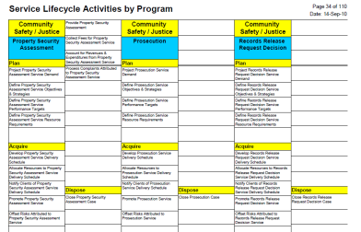
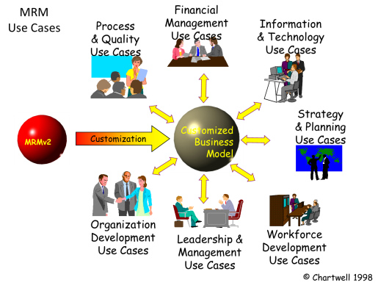

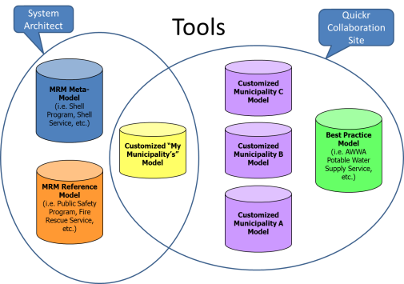

What’s in the Subscriber’s Line of Sight Now?
My Business
Model
Governed
Standards
Common
Language
Use Cases
Tools
Training, Support
& Consulting

Slide 4
MRM Value: helps manage complex change caused by constantly shifting demands and unceasing innovation
Features
Common Language - for describing, planning, designing and evaluating municipal activities
Advantages
Strengthens and unifies employee views of municipal purposes, activities, linkages, results
Standardizes and integrates analyses of municipal performance; traces causes and effects of variance
Benefits
Smarter Organization: better able to ‘act as one’; people more capable through better understanding
Business Model - for formalizing, recording and aligning a municipality’s organization, operations, plans and designs
Makes the abstract real; breaks goals and problems into manageable parts; avoids organizational biases
Acts as corporate memory; helps analyze all impacts of management decisions
Use Cases – step-by-step Business Model guide for improving management practices and introducing new capabilities
Governed Standards - for comparing practices and results between municipalities and learning
Renders more accurate comparisons with other municipalities; shows patterns more clearly; deepens insights
Smarter Leadership: able to define desired outcomes and impacts more coherently
Smarter Use of Resources: able to define needs and weigh resources against outcomes more precisely
Smarter Systems: able to define business requirements, align and integrate solutions more effectively
Tools – for maintaining and using Business Models and collaborating with other municipalities
Smarter Change: able to plan complex changes and mitigate risks more effectively
Notes:
There is nothing else that does this for municipal government.
Range of potential applications – benefits are derived from more specific uses. More concrete benefits are in the use cases.

Slide 5
Short History of the MRM
Era | Business Model | Governance Model | Tools | Results
MRMv1 Program 1995-98 | Development sponsorships; annual user fees | Joint Venture; (Chartwell under contract) | Red Books, shareware CASE tool | Modest subscriber growth including several businesses; modest consulting revenue
Transition 1 c. 1998 | Subscription fees dropped | Chartwell licensed for unrestricted use
Chartwell 1999-2009 | Consulting revenue | Market driven | Chartwell ScribeIT (MS Access); spreadsheets | Significant revenues and SR&ED tax credits; substantial product develop-ment; MRM/IS; PSRM; GSRM; MSMotion
Transition 2 c. 2009 | Chartwell acquired by KPMG | IP ownership clarified
MRMv2 Project 2007-2011 | Development sponsorships & partner investments; user subscription fees (tentative) | MISA/ASIM ; user working groups (including business partners informally) | SDW (Service Design Work-bench); collaboration site; limited-function spreadsheet | Significant product development; still considerable ‘market’ interest
Notes:
Alan was director of the MRMv1 program

Slide 6
Lessons Learned
Very complex ‘product’ (40+ diverse use cases); easy to be interested, hard to learn and apply; systematic thinking is not always seen as desirable
Appeals to C-levels with corporate perspective: CFO, CAO, CIO; but hard to find a natural ‘home’ for the model
IT seems the obvious place to start (since MISA is the sponsor), but Finance and Planning produce better takeup
Takeup is 2-3 years, in a succession of business projects; first step should be service definition, which can be controversial
Perception of MRM value depends largely on each project’s business value and risk
Value within a municipality is large and proven (200+ projects); value between municipalities is relatively untested (federal projects only)
Concept universality has failed to overcome the pecking order between levels of government (so far).
Private sector will participate but only if it is a ‘standard’; otherwise seen as competition
Notes:
All the ways in which the MRM has established itself is because of business motivation while the MRM is being developed, maintained, and funded in the context of IT.

Slide 7

What does the MRMv2 want to be when it grows up?
?
A Standard?
A Product?
Public Domain Information?
Notes:
Finished with the Product Era – go down to public domain or up to standard.

Slide 8
Standards bodies
Sovereign bodies
One member per country
Government-supported
Examples: ISO, IEC, ITU
Not the model we’re looking for
Industry bodies
Open to organizations & individuals, public and private sector, anyone accepting the bylaws
Member-supported through membership and certification fees, product sales
Examples: IEEE, IETF, W3C, UN/CEFACT
Closer to the mark for the MRM

Slide 9
Parallels with the MRM
Organization | Example Standards | Form | Stakeholders | Users
OMG Object Management Group | BMM (Business Motivation Model), UML (Unified Modeling Language) | Specifications, e.g. metamodel | Methods and software suppliers and practitioners/ integrators | Business and systems analysts
PPDMA Public Petroleum Data Model Assoc. | PPDM (Public Petroleum Data Model) | Data model | Oil industry (upstream & downstream), governments | Business and systems analysts
TM Forum Telemanagement Forum | eTOM (enhanced Telecom Operations Map) | Reference model – functions, processes | Telcos, cable/network operators, software & equipment suppliers, system integrators | Business planners, business and systems analysts, electronic equipment designers
SCC Supply Chain Council | SCOR Supply Chain Operations Reference | Reference model – functions, processes | Distribution industry, manufacturers, retailers | Business planners, business and systems analysts, equipment designers
itSMF IT Service Management Forum | ITIL IT Infrastructure Library | Reference model - practices | IT executives and service managers, IT management consultants | IT planners, business analysts

Slide 10
Common Themes
Membership is voluntary , multi-sector and multi-national
Funding comes from membership fees, member levies and “product” sales and certification (ISO and UN/CEFACT are heavily subsidized by sovereign members)
Business and technical governance are split in every case
Entire membership typically agrees product development plans and priorities through various mechanisms
Product development work is typically performed by volunteer member workgroups (OMG tenders and contracts out development work)
Product approval decision-making is typically performed by entire membership via multi-gate voting

Slide 11
What does the MRMv2 want to be when it grows up?
?
A Standard?
A Product?
Public Domain Information?

Slide 12
Common Language

Slide 13

Municipality’s Business Model (Part of a view shown here)

Slide 14


MRM
Use Cases
Financial
Management
Use Cases
Process
& Quality
Use Cases
Information
& Technology
Use Cases
Strategy
& Planning
Use Cases
Customization
Customized
Business
Model
MRMv2
Organization
Development
Use Cases
Leadership &
Management
Use Cases
Workforce
Development
Use Cases
© Chartwell 1998

Slide 15
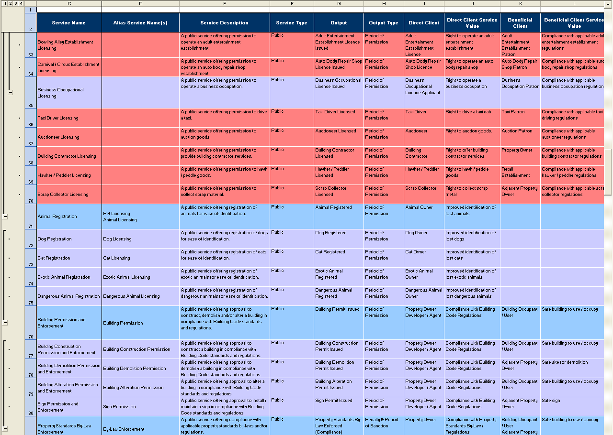
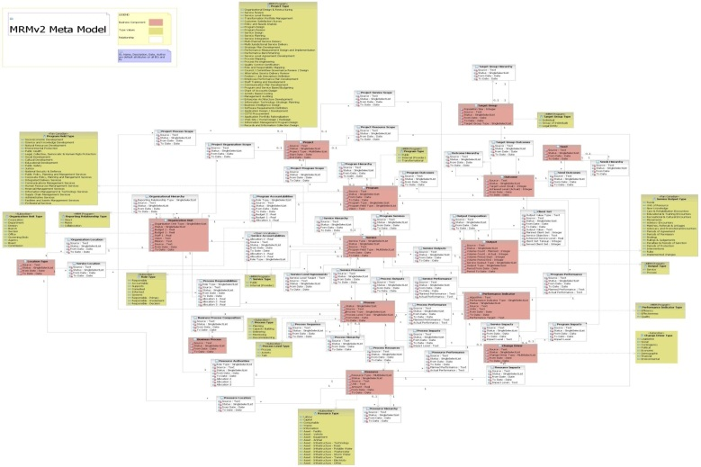
Governed Standards
PSAM
Analytic
Models
Reference
Model
Programs
Vertical
Account-ability
PLM
Target Group Needs
Target
Groups
Strategic Outcomes
Inter-mediate Outcomes
Direct
Outcomes
Public Service Outputs
Public Services
Horizontal Account-ability
Service Processes
Resources
SIAM
MetaModel
Provider Service Outputs
Provider Services
Workflow

Slide 16
Tools
System
Architect
Quickr
Collaboration Site
MRM Meta-Model
(i.e. Shell Program, Shell Service, etc.)
Customized Municipality C Model
Best Practice Model
(i.e. AWWA Potable Water Supply Service, etc.)
Customized “My Municipality’s” Model
Customized Municipality B Model
MRM Reference Model
(i.e. Public Safety Program, Fire Rescue Service, etc.)
Customized Municipality A Model

